Slide 1

RStudio Project

Slide 2
Introduction
This dataset was sourced through Kaggle, and contains profit metrics for different Walmart stores over time
The goal of this project is to demonstrate my ability to use RStudio as a means to plot and analyse data
Packages used within this project are: ggplot2, readr, summarytools, dplyr and tidyverse.

Slide 3
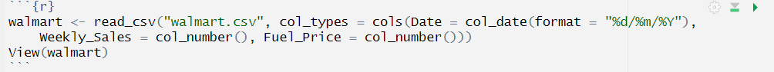
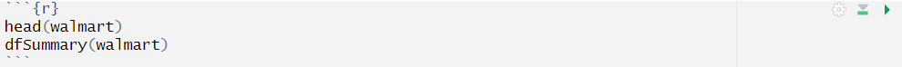
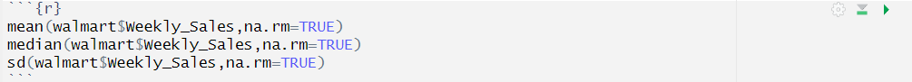
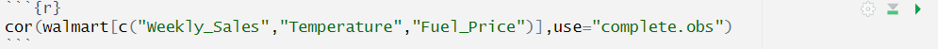
Data Handling
Importing the walmart.csv dataset with the correct column formats
Preliminary Structure Checks
Basic Central Tendency Measures
Correlational measures

Slide 4
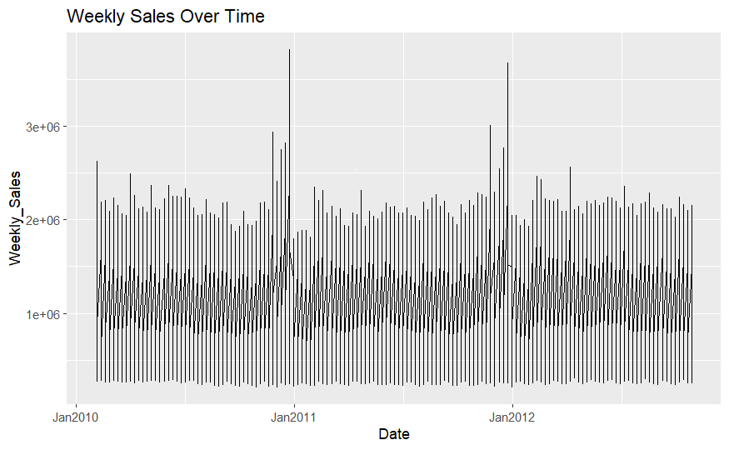
Initial Plotting
Dataset was clearly not suitable for plotting over time initially
This was due to weekly sales counts being stored in the raw data from different stores

Slide 5
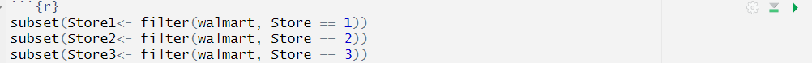
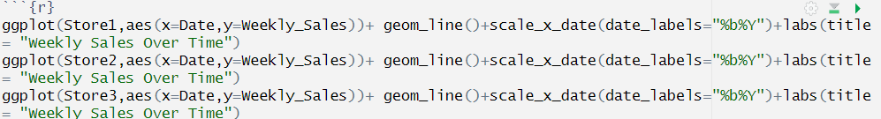
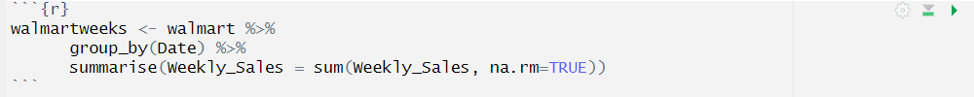
Transforming data for plotting & analysis
Subsetting the data into different stores
Plotting store data independently
Creating a new object based on walmart data with a new column of sales across all stores
Individual stores showed similar seasonality in general when plotted, with some outliers to be plotted individually in depth

Slide 6
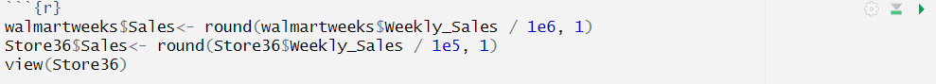
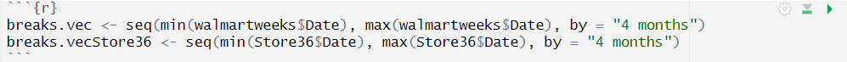
Transforming data for plotting & analysis
Creating a new column with fixed units for more practical data visualisation
Creating x axis breaks on the plot to ensure labelling begins with plot boundary

Slide 7
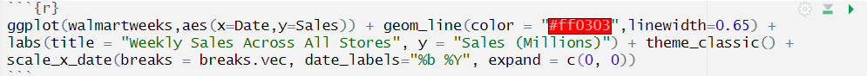
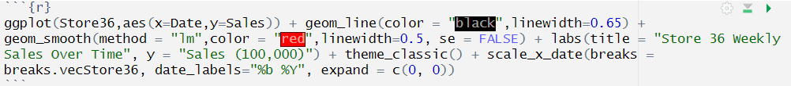
Code for Data Visualisations
Plotting and designing graph to show weekly sales for all stores
Plotting and designing graph to show weekly sales for one store that showed to be outlier when initially plotting different stores

Slide 8
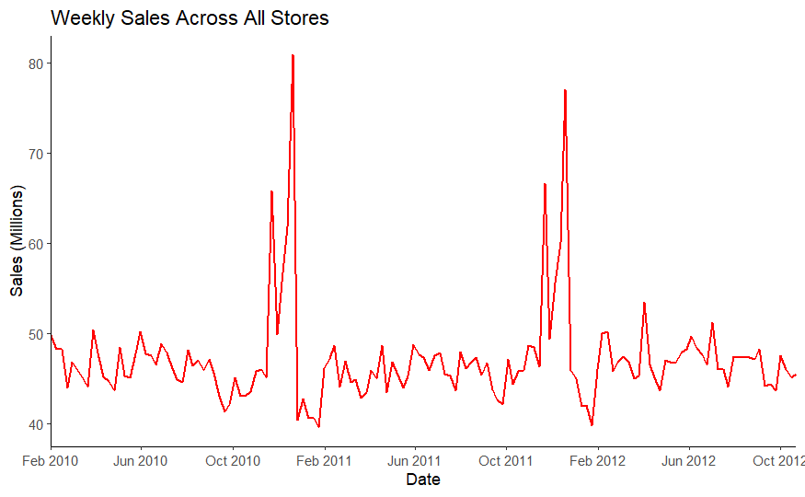
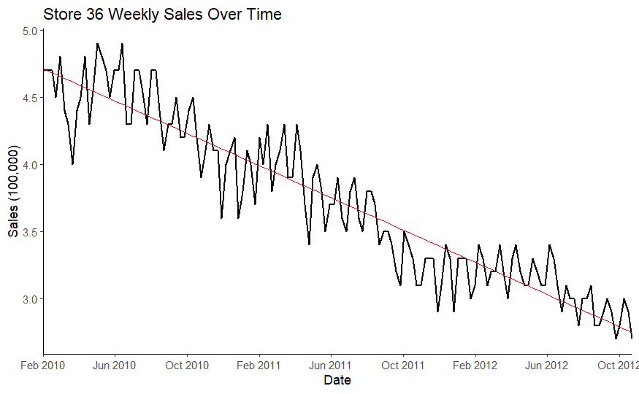
Data Visualisations
This visualisation shows the weekly sum sales across all Walmart stores in millions. Most individual stores when plotted followed this profile closely.
This visualisation shows one store with a strong negative trend in sales over time since the earliest dataset records, fitted with a plotted linear model through ggplot2

Slide 9
Conclusions
There is a strong seasonal profile present in most stores within Walmart, in which the period before Christmas was associated with a spike in sales
Most stores don’t exhibit any immediate positive or negative correlation over time visually, however store 36 did display a continuous and predictable decrease in sales over time

